Slide 1
APUSH Review: Key Concept 5.2, Revised (Most up-to-date version)
Everything You Need To Know About Key Concept 5.2 To Succeed In APUSH

Slide 2

Key Concept 5.2
“Intensified by expansion and Deepening regional divisions, debates over slavery and other economic, cultural, and political issues led the nation into civil war.”
Pg. 55
Big Idea Questions:
Why did various government actions regarding the issue of slavery fail?
Why did the election of 1860 lead to secession by South Carolina and other states?

Slide 3

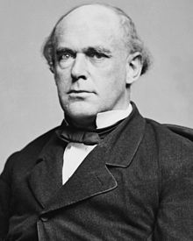
Key Concept 5.2, I
“Ideological and economic differences over slavery produced an array of diverging responses from Americans in the North and the South.”
A) 2 Economies:
North - manufacturing that relied on free labor
South - agriculture - reliant on slavery
Free Soil movement - sought to keep slavery from expanding
Especially in land out west -> Mexican Cession
Believed slavery was incompatible with free labor
I coined the phrase, “Free Labor, Free Soil, Free Men.”

Slide 4
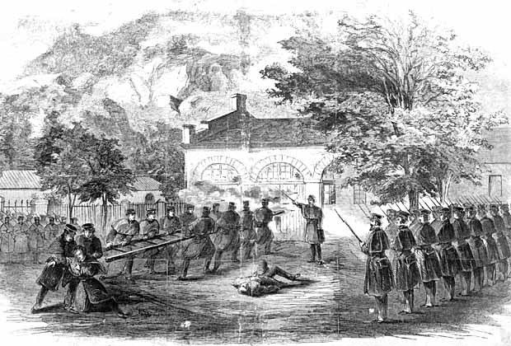
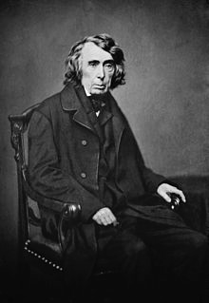
Key Concept 5.2, I
B) Abolitionist movement:
Comprised of whites and blacks, small percentage of population in the North
Tactics used by the abolitionist movement:
Moral arguments - incompatible with “natural rights” and “all men are created equal”
Assisting slaves’ escapes - Underground RR
Willingness to use violence - John Brown @ Harpers Ferry
C) Arguments used to defend slavery:
Racial doctrines - African Americans, like Native Americans before, were seen as “savages”
Slavery was a “Positive Good”
Constitution - believed slavery protected states’ rights and slavery (slaves were deemed as property in Dred Scott, property can’t be taken away)

Slide 5

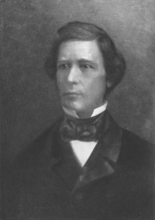
Key Concept 5.2, II
“Provided, That, as an express and fundamental condition to the acquisition of any territory from the Republic of Mexico by the United States, by virtue of any treaty which may be negotiated between them, and to the use by the Executive of the moneys herein appropriated, neither slavery nor involuntary servitude shall ever exist in any part of said territory, except for crime, whereof the party shall first be duly convicted.”
“Debates over slavery came to dominate political discussions in the 1850s, culminating in the bitter election of 1860 and the secession of Southern states.”
A) Mexican Cession -> debates over slavery
Wilmot Proviso - sought to ban slavery in the Mexican Cession
Passed the House, NOT the Senate

Slide 6
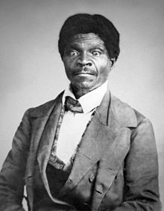
Key Concept 5.2, II
B) Attempts to resolve slavery issue in the territories
Courts:
Dred Scott v. Sanford:
African Americans (free and slave) were deemed not citizens and could not sue
Slaves were considered property, could not be taken away (5th amendment)
Congress could NOT regulate slavery in territories
Helped split the Democratic party along sectional lines

Slide 7
Key Concept 5.2, II
B) Attempts to resolve slavery issue in the territories
National Leaders:
Compromise of 1850 (Douglass and Clay)
Major Parts:
CA was added as a free state - (tips balance in favor of free states)
Slave trade was abolished in D.C.
Popular Sovereignty in Mexican Cession
More strict fugitive slave law -> personal liberty laws in the North
Kansas-Nebraska Act (Douglass)
Allowed for popular sovereignty in KS and NB - expectation was KS would be slave, NB would be free
Overturned the MO Compromise
Helped lead to the creation of the Republican Party

Slide 8
Key Concept 5.2, II
C) End of the Second Party System:
Declined due to issues over slavery and anti-immigration sentiments
Led to the emergence of sectional parties (see election of 1860)
Republican Party emerged in the North
Made up of Free-Soilers and former Whigs
Lincoln’s platform in 1860 was the NONEXTENSION of slavery

Slide 9
Key Concept 5.2, II
D) Election of 1860 - Lincoln wins on a free-soil platform, without a SINGLE Southern electoral vote from the South
He did NOT want to end slavery, but keep it from spreading
Immediate cause of the Civil War
South Carolina secedes on December 20, 1860, many states follow shortly after

Slide 10
Test Tips
Multiple-Choice and Short Answer
Reasons for the decline of the Second Party System
Characteristics of the abolitionist movement
Compromise of 1850, Kansas-Nebraska Act, and the Dred Scott decision
Essay Topics:
Government actions that sought to settle the issue of slavery

Slide 11
See You Back For Key Concept 5.3!
Thanks for watching
Good luck in May!

